Slide 1
Java Collections Framework
Shahjahan Samoon

Slide 2
Collections
A collection is a structured group of objects
Java 1.2 introduced the Collections Framework
  Collections are defined in java.util
  The Collections framework is mostly about interfaces
  There are a number of predefined implementations
Java 5 introduced generics and “genericized” all the existing collections
  Vectors have been redefined to implement Collection
  Trees, linked lists, stacks, hash tables, and other classes are implementations of Collection
  Arrays do not implement the Collection interfaces

Slide 3
The Java Collections Framework
A collection — sometimes called a container — is simply an object that groups multiple elements into a single unit.
Collections are used to store, retrieve, manipulate, and communicate aggregate data.
Typically, they represent data items that form a natural group, such as
  a poker hand (a collection of cards),
  a mail folder (a collection of letters), or
  a telephone directory (a mapping of names to phone numbers).

Slide 4
The Java Collections Framework
  A collections framework is a unified architecture for representing and manipulating collections.
  All collections frameworks contain the following:
  Interfaces: These are abstract data types that represent collections. Interfaces allow collections to be manipulated independently of the details of their representation. In object-oriented languages, interfaces generally form a hierarchy.
  Implementations: These are the concrete implementations of the collection interfaces. In essence, they are reusable data structures.
  Algorithms: These are the methods that perform useful computations, such as searching and sorting, on objects that implement collection interfaces.
  The algorithms are said to be polymorphic: that is, the same method can be used on many different implementations of the appropriate collection interface. In essence, algorithms are reusable functionality.

Slide 5
Benefits of the JCF
  Reduces programming effort:
  By providing useful data structures and algorithms, the Collections Framework frees you to concentrate on the important parts of your program rather than on the low-level "plumbing" required to make it work.
  Increases program speed and quality:
  This Collections Framework provides high-performance, high-quality implementations of useful data structures and algorithms. you'll have more time to devote to improving programs' quality and performance.
  Reduces effort to learn and to use new APIs:
  In the past, each such API had a small sub-API devoted to manipulating its collections. There was little consistency among these ad hoc collections sub-APIs, so you had to learn each one from scratch, and it was easy to make mistakes when using them. With the advent of standard collection interfaces, the problem went away.

Slide 6
Benefits of the JCF
  Reduces effort to design new APIs:
  Designers and implementers don't have to reinvent the wheel each time they create an API that relies on collections; instead, they can use standard collection interfaces.
  Fosters software reuse:
  New data structures that conform to the standard collection interfaces are by nature reusable. The same goes for new algorithms that operate on objects that implement these interfaces.

Slide 7
The Java Collections Framework
An array is a very useful type in Java but it has its restrictions:
once an array is created it must be sized, and this size is fixed;
it contains no useful pre-defined methods.
Java comes with a group of generic collection classes that grow as more elements are added to them, and these classes provide lots of useful methods.
This group of collection classes are referred to as the Java Collections Framework.
The classes in the JCF are all found in the java.util package.
Three important interfaces from this group are:
  List;
  Set;
  Map.

Slide 8
Types of Collection
Java supplies several types of Collection:
  Set: cannot contain duplicate elements, order is not important
  SortedSet: like a Set, but order is important
  List: may contain duplicate elements, order is important
Java also supplies some “collection-like” things:
  Map: a “dictionary” that associates keys with values, order is not important
  SortedMap: like a Map, but order is important
While you can get all the details from the Java API, you are expected to learn (i.e. memorize):
  The signatures of the “most important” methods in each interface
  The most important implementations of each interface

Slide 9
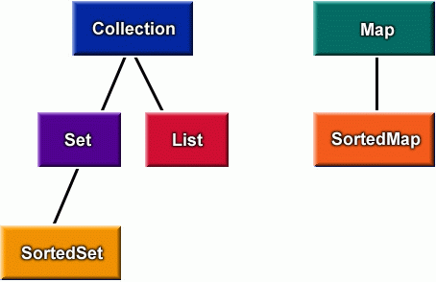
The Collections hierarchy

Slide 10
Collections are ADTs
Collections are one of the best-designed parts of Java, because
  They are elegant: they combine maximum power with maximum simplicity
  They are uniform: when you know how to use one, you almost know how to use them all
  You can easily convert from one to another

Slide 11
The Collection interface
Much of the elegance of the Collections Framework arises from the intelligent use of interfaces
The Collection interface specifies (among many other operations):
  boolean add(E o)
  boolean contains(Object o)
  boolean remove(Object o)
  boolean isEmpty()
  int size()
  Object[] toArray()
  Iterator<E> iterator()
You should learn all the methods of the Collection interface--all are important

Slide 12
The Iterator interface
An iterator is an object that will return the elements of a collection, one at a time
interface Iterator<E>
  boolean hasNext()
    Returns true if the iteration has more elements
  E next()
    Returns the next element in the iteration
  void remove()
    Removes from the underlying collection the last element returned by the iterator (optional operation)

Slide 13
The Set interface
A set is a collection in which:
  There are no duplicate elements (according to equals), and
  Order is not important
interface Set<E> implements Collection, Iterable
The methods of Set are exactly the ones in Collection
The following methods are especially interesting:
  boolean contains(Object o) // membership test
  boolean containsAll(Collection<?> c) //subset test
  boolean addAll(Collection<? extends E> c) // union
  boolean retainAll(Collection<?> c) // intersection
  boolean removeAll(Collection<?> c) // difference
addAll, retainAll, and removeAll return true if the receiving set is changed, and false otherwise

Slide 14
The List interface
A list is an ordered sequence of elements
interface List<E> extends Collection, Iterable
Some important List methods are:
  void add(int index, E element)
  E remove(int index)
  boolean remove(Object o)
  E set(int index, E element)
  E get(int index)
  int indexOf(Object o)
  int lastIndexOf(Object o)
  ListIterator<E> listIterator()
    A ListIterator is like an Iterator, but has, in addition, hasPrevious and previous methods

Slide 15
The SortedSet interface
A SortedSet is a Set for which the order of elements is important
interface SortedSet<E>
implements Set, Collection, Iterable
Two of the SortedSet methods are:
  E first()
  E last()
More interestingly, only Comparable elements can be added to a SortedSet, and the set’s Iterator will return these in sorted order
The Comparable interface is covered in a separate lecture

Slide 16
The Map interface
A map is a data structure for associating keys and values
Interface Map<K,V>
The two most important methods are:
  V put(K key, V value) // adds a key-value pair to the map
  V get(Object key) // given a key, looks up the associated value
Some other important methods are:
  Set<K> keySet()
    Returns a set view of the keys contained in this map.
  Collection<V> values()
    Returns a collection view of the values contained in this map

Slide 17
The SortedMap interface
A sorted map is a map that keeps the keys in sorted order
Interface SortedMap<K,V>
Two of the SortedMap methods are:
  K firstKey()
  K lastKey()
More interestingly, only Comparable elements can be used as keys in a SortedMap, and the method Set<K> keySet() will return a set of keys whose iterator will return them sorted order
The Comparable interface is covered in a separate lecture

Slide 18
Some implementations
class HashSet<E> implements Set
class TreeSet<E> implements SortedSet
class ArrayList<E> implements List
class LinkedList<E> implements List
class Vector<E> implements List
  class Stack<E> extends Vector
    Important methods: push, pop, peek, isEmpty
class HashMap<K, V> implements Map
class TreeMap<K, V> implements SortedMap
All of the above provide a no-argument constructor

Slide 19
The List interface
The List interface specifies the methods required to process an ordered list of objects.
Such a list may contain duplicates.
Examples of a list of objects:
  jobs waiting for a printer,
  emergency calls waiting for an ambulance
  the names of players that have won the Wimbledon tennis tournament over the last 10 years.
we often think of such a collection as a sequence of objects.
there are two implementations provided for the List interface in the JCF.
they are ArrayList and LinkedList.
here we will look at the ArrayList class

Slide 20

Using an ArrayList to store a queue of jobs waiting for a printer
We will represent these jobs by a series of Job ID Strings.
The ArrayList constructor creates an empty list:
The stuff in angled brackets is a new feature introduced in Java 5 that allows us to fix the type of objects stored in a particular collection object.
This feature is called generics.

Slide 21

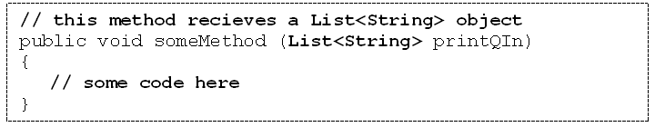
Using the interface type instead of the implementation type
It is considered good programming practice to declare collection objects to be the type of the interface rather than the type of the class that implements this collection.
So this would be a better way to create our printQ object:
A method that receives a printQ object, would now be declared as follows:
The advantage of this approach is that we can change our choice of implementation in the future without having to change the type of the object.

Slide 22
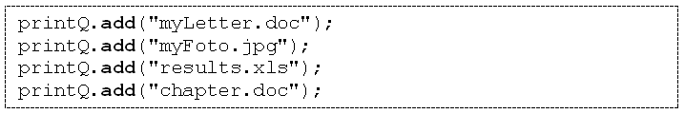
List methods - add
The List interface defines two add methods for inserting into a list
  one inserts the item at the end of the list;
  the other inserts the item at a specified position in the list.
We wish to use the first add method
This add method requires one parameter, the object to be added into the list:

Slide 23

List methods - toString
All the Java collection types have a toString method defined
So we can display the entire list to the screen:
Lists are displayed as follows.
[myLetter.doc, myFoto.jpg, results.xls, chapter.doc]

Slide 24

List methods – add revisited
The add method is overloaded to allow an item to be inserted into the list at a particular position.
When the item is inserted into that position, the item previously at that particular position and all items behind it shuffle along by one place.
This add method requires two parameters, the position into which the object should be inserted, and the object itself.

Slide 25
List methods – set
If we wish to overwrite an item in the list, rather than insert a new item into the list, we can use the set method.
The set method requires two parameters, the index of the item being overwritten and the new object to be inserted at that position.
Let us change the name of the last job from "chapter.doc", to "newChapter.doc".

Slide 26

List methods – size
Lists provide a size method to return the number of items in the list
So we could have renamed the last job in the queue in the following way also:

Slide 27
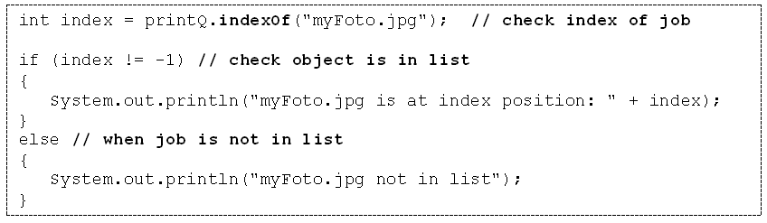
List methods – indexOf
The indexOf method returns the index of the first occurrence of a given object within the list.
It returns -1 if the object is not in the list.
Example: finding “myFoto.jpg”

Slide 28
List methods – remove
Items can be removed either by specifying an index or an object.
When an item is removed, items behind this item shuffle to the left
Example : removing "myFoto.jpg"
If we used its index, the following is required
Alternatively, we could have removed the item by referring to it directly rather than its index:

Slide 29

List methods – get
The get method allows a particular item to be retrieved from the list via its index position.
The following displays the job at the head of the queue:
This would display the following:
First job is importantMemo.doc

Slide 30
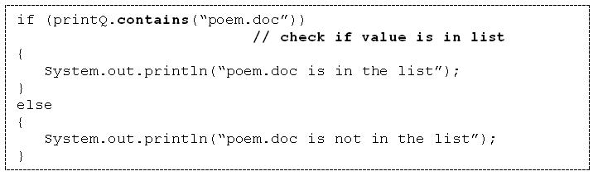
List methods – contains
The contains method can be used to check whether or not a particular item is present in the list:

Slide 31
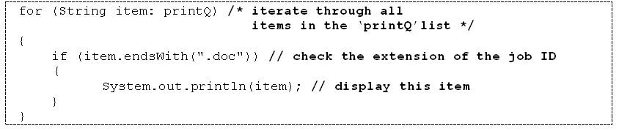
List methods – isEmpty
The isEmpty method reports on whether or not the list contains any items
Using the enhanced ‘for’ loop with collection classes
The enhanced for loop can be used with the List (and Set) implementations provided in the JCF.
For example, here an enhanced for loop is used to iterate through the printQ list to find and display those jobs that end with a “.doc” extension:

Slide 32
Sets
set: A collection of unique values (no duplicates allowed)
that can perform the following operations efficiently:
  add, remove, search (contains)
  We don't think of a set as having indexes; we just
  add things to the set in general and don't worry about order
"the"
"of"
"if"
set.contains("to")
"to"
"down"
"from"
true
"by"
"she"
set.contains("be")
"you"
false
"in"
"why"
"him"
set

Slide 33
Set implementation
in Java, sets are represented by Set interface in java.util
Set is implemented by HashSet and TreeSet classes
  HashSet: implemented using a "hash table" array;
  elements are stored in unpredictable order
  TreeSet: implemented using a "binary search tree";
  elements are stored in sorted order

Slide 34
Set methods
List<String> list = new ArrayList<String>();
...
Set<Integer> set = new TreeSet<Integer>(); // empty
Set<String> set2 = new HashSet<String>(list);
  can construct an empty set, or one based on a given collection
add(value) | adds the given value to the set
contains(value) | returns true if the given value is found in this set
remove(value) | removes the given value from the set
clear() | removes all elements of the set
size() | returns the number of elements in list
isEmpty() | returns true if the set's size is 0
toString() | returns a string such as "[3, 42, -7, 15]"

Slide 35
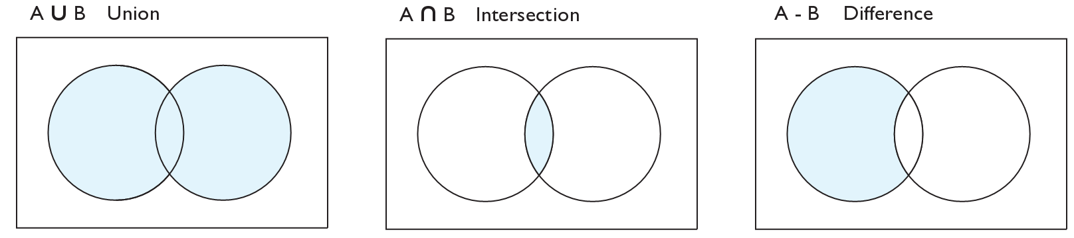
Set operations
addAll
retainAll
removeAll
addAll(collection) | adds all elements from the given collection to this set
containsAll(coll) | returns true if this set contains every element from given set
equals(set) | returns true if given other set contains the same elements
iterator() | returns an object used to examine set's contents (seen later)
removeAll(coll) | removes all elements in the given collection from this set
retainAll(coll) | removes elements not found in given collection from this set
toArray() | returns an array of the elements in this set

Slide 36
Sets and ordering
HashSet : elements are stored in an unpredictable order
  Set<String> names = new HashSet<String>();
  names.add("Jake");
  names.add("Robert");
  names.add("Marisa");
  names.add("Kasey");
  System.out.println(names);
  // [Kasey, Robert, Jake, Marisa]
TreeSet : elements are stored in their "natural" sorted order
  Set<String> names = new TreeSet<String>();
  ...
  // [Jake, Kasey, Marisa, Robert]
LinkedHashSet : elements stored in order of insertion
  Set<String> names = new LinkedHashSet<String>();
  ...
  // [Jake, Robert, Marisa, Kasey]

Slide 37
The "for each" loop
for (type name : collection) {
statements;
}
Provides a clean syntax for looping over the elements of a Set, List, array, or other collection
  Set<Double> grades = new HashSet<Double>();
  ...
  for (double grade : grades) {
  System.out.println("Student's grade: " + grade);
  }
  needed because sets have no indexes; can't get element i

Slide 38
Maps vs. sets
A set is like a map from elements to boolean values.
  Set: Is "Marty" found in the set? (true/false)
  Map: What is "Marty" 's phone number?
"Marty"
Set
true
false
"Marty"
Map
"206-685-2181"

Slide 39
keySet and values
keySet method returns a Set of all keys in the map
  can loop over the keys in a foreach loop
  can get each key's associated value by calling get on the map
  Map<String, Integer> ages = new TreeMap<String, Integer>();
  ages.put("Marty", 19);
  ages.put("Geneva", 2); // ages.keySet() returns Set<String>
  ages.put("Vicki", 57);
  for (String name : ages.keySet()) { // Geneva -> 2
  int age = ages.get(age); // Marty -> 19
  System.out.println(name + " -> " + age); // Vicki -> 57
  }
values method returns a collection of all values in the map
  can loop over the values in a foreach loop
  no easy way to get from a value to its associated key(s)

Slide 40
Problem: opposite mapping
It is legal to have a map of sets, a list of lists, etc.
Suppose we want to keep track of each TA's GPA by name.
  Map<String, Double> taGpa = new HashMap<String, Double>();
  taGpa.put("Jared", 3.6);
  taGpa.put("Alyssa", 4.0);
  taGpa.put("Steve", 2.9);
  taGpa.put("Stef", 3.6);
  taGpa.put("Rob", 2.9);
  ...
  System.out.println("Jared's GPA is " +
  taGpa.get("Jared")); // 3.6
This doesn't let us easily ask which TAs got a given GPA.
  How would we structure a map for that?

Slide 41
Reversing a map
We can reverse the mapping to be from GPAs to names.
  Map<Double, String> taGpa = new HashMap<Double, String>();
  taGpa.put(3.6, "Jared");
  taGpa.put(4.0, "Alyssa");
  taGpa.put(2.9, "Steve");
  taGpa.put(3.6, "Stef");
  taGpa.put(2.9, "Rob");
  ...
  System.out.println("Who got a 3.6? " +
  taGpa.get(3.6)); // ???
What's wrong with this solution?
  More than one TA can have the same GPA.
  The map will store only the last mapping we add.

Slide 42
Proper map reversal
Really each GPA maps to a collection of people.
  Map<Double, Set<String>> taGpa =
  new HashMap<Double, Set<String>>();
  taGpa.put(3.6, new TreeSet<String>());
  taGpa.get(3.6).add("Jared");
  taGpa.put(4.0, new TreeSet<String>());
  taGpa.get(4.0).add("Alyssa");
  taGpa.put(2.9, new TreeSet<String>());
  taGpa.get(2.9).add("Steve");
  taGpa.get(3.6).add("Stef");
  taGpa.get(2.9).add("Rob");
  ...
  System.out.println("Who got a 3.6? " +
  taGpa.get(3.6)); // [Jared, Stef]
  must be careful to initialize the set for a given GPA before adding

Slide 43
Iterators

Slide 44
Examining sets and maps
elements of Java Sets and Maps can't be accessed by index
  must use a "foreach" loop:
  Set<Integer> scores = new HashSet<Integer>();
  for (int score : scores) {
  System.out.println("The score is " + score);
  }
  Problem: foreach is read-only; cannot modify set while looping
  for (int score : scores) {
  if (score < 60) {
  // throws a ConcurrentModificationException
  scores.remove(score);
  }
  }

Slide 45
Iterators
iterator: An object that allows a client to traverse the elements of any collection.
  Remembers a position, and lets you:
    get the element at that position
    advance to the next position
    remove the element at that position
index | 0 | 1 | 2 | 3 | 4 | 5 | 6 | 7 | 8 | 9
value | 3 | 8 | 9 | 7 | 5 | 12 | 0 | 0 | 0 | 0
size | 6
"the"
list
set
"to"
"we"
"from"
current element: 9
current index: 2
current element: "from"
next element: "the"
iterator
iterator

Slide 46
Iterator methods
Iterator interface in java.util
  every collection has an iterator() method that returns an iterator over its elements
  Set<String> set = new HashSet<String>();
  ...
  Iterator<String> itr = set.iterator();
  ...
hasNext() | returns true if there are more elements to examine
next() | returns the next element from the collection (throws a NoSuchElementException if there are none left to examine)
remove() | removes the last value returned by next() (throws an IllegalStateException if you haven't called next() yet)

Slide 47
Iterator example
Set<Integer> scores = new TreeSet<Integer>();
scores.add(94);
scores.add(38); // Kim
scores.add(87);
scores.add(43); // Marty
scores.add(72);
...
Iterator<Integer> itr = scores.iterator();
while (itr.hasNext()) {
int score = itr.next();
System.out.println("The score is " + score);
// eliminate any failing grades
if (score < 60) {
itr.remove();
}
}
System.out.println(scores); // [72, 87, 94]

Slide 48
Iterator example 2
Map<String, Integer> scores = new TreeMap<String, Integer>();
scores.put("Kim", 38);
scores.put("Lisa", 94);
scores.put("Roy", 87);
scores.put("Marty", 43);
scores.put("Marisa", 72);
...
Iterator<String> itr = scores.keySet().iterator();
while (itr.hasNext()) {
String name = itr.next();
int score = scores.get(name);
System.out.println(name + " got " + score);
// eliminate any failing students
if (score < 60) {
itr.remove(); // removes name and score
}
}
System.out.println(scores); // {Lisa=94, Marisa=72, Roy=87}

Slide 49
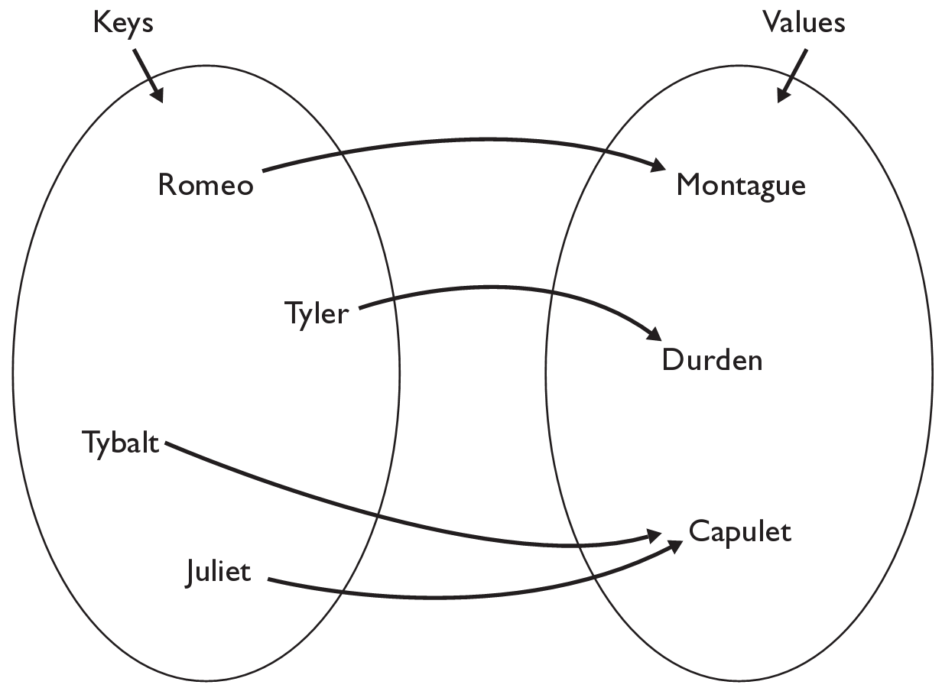
The Map
map: Holds a set of unique keys and a collection of values, where each key is associated with one value.
  a.k.a. "dictionary", "associative array", "hash"
basic map operations:
  put(key, value ): Adds a
  mapping from a key to
  a value.
  get(key ): Retrieves the
  value mapped to the key.
  remove(key ): Removes
  the given key and its
  mapped value.
myMap.get("Juliet") returns "Capulet"

Slide 50
Map implementation
in Java, maps are represented by Map interface in java.util
Map is implemented by the HashMap and TreeMap classes
  A map requires 2 type parameters: one for keys, one for values.
// maps from String keys to Integer values
Map<String, Integer> votes = new HashMap<String, Integer>();

Slide 51
Map methods
put(key, value) | adds a mapping from the given key to the given value; if the key already exists, replaces its value with the given one
get(key) | returns the value mapped to the given key (null if not found)
containsKey(key) | returns true if the map contains a mapping for the given key
remove(key) | removes any existing mapping for the given key
clear() | removes all key/value pairs from the map
size() | returns the number of key/value pairs in the map
isEmpty() | returns true if the map's size is 0
toString() | returns a string such as "{a=90, d=60, c=70}"
keySet() | returns a set of all keys in the map
values() | returns a collection of all values in the map
putAll(map) | adds all key/value pairs from the given map to this map
equals(map) | returns true if given map has the same mappings as this one

Slide 52
Using maps
A map allows you to get from one half of a pair to the other.
  Remembers one piece of information about every index (key).
  Later, we can supply only the key and get back the related value:
    Allows us to ask: What is Marty's phone number?
// key value
put("Marty", "206-685-2181")
Map
get("Marty")
Map
"206-685-2181"

Slide 53
keySet and values
keySet method returns a set of all keys in the map
  can loop over the keys in a foreach loop
  can get each key's associated value by calling get on the map
  Map<String, Integer> ages = new HashMap<String, Integer>();
  ages.put("Marty", 19);
  ages.put("Geneva", 2);
  ages.put("Vicki", 57);
  for (String name : ages.keySet()) { // Geneva -> 2
  int age = ages.get(age); // Marty -> 19
  System.out.println(name + " -> " + age); // Vicki -> 57
  }
values method returns a collection of all values in the map
  can loop over the values in a foreach loop
  there is no easy way to get from a value to its associated key(s)

Slide 54
Further Readings
http://docs.oracle.com/javase/tutorial/collections

